Slide 1

WEBSITE TRAFFIC FORECASTING
TIME SERIES PROJECT
Inshiya Fakhri
Date: 09 April 2025

Slide 2
AGENDA
Business objective
Project benefits & importance
Data Collection & Details
Exploratory data analysis
Feature Engineering
Model Selection & Traning
Model Evaluation
Manchine learning model
Conclusion
Business objective
Data Collection & Details
Exploratory data analysis
Feature Engineering
Model Selection & Traning
Model Evaluation
Conclusion

Slide 3
Business Objective
The objective of this project is to forecast website traffic, specifically page loads and visits, using
historical time series data. The goal is to build accurate forecasting models that can help the
business predict future user activity on the website. This will assist in planning marketing
strategies, optimizing server usage, and improving user experience by anticipating demand.
The objective of this project is to forecast website traffic, specifically page loads and visits, using
historical time series data. The goal is to build accurate forecasting models that can help the
business predict future user activity on the website. This will assist in planning marketing
strategies, optimizing server usage, and improving user experience by anticipating demand.

Slide 4
Project Benefits & Importance
“This project helps businesses anticipate web traffic by using both historical data and user behavior patterns. By doing this, companies can prepare for upcoming traffic, plan marketing campaigns effectively, and manage resources more efficiently all of which lead to better performance and cost savings.”

Slide 5
Data Collection & Details
Total Records: 2167 rows & 8 column
Year range: 14-09-2014 to 19-08-2020
1. Data Preprocessing
Converted Date column to proper datetime format , set Date as the index for time series modeling.
2. Data Type Correction
Columns like Page_Loads , Unique_Visits , First_time_visits , and Returning_visits were in object type Due to presence of commas.
Removed commas and converted them to float for numerical analysis
Target variable: Page_Loads

Slide 6
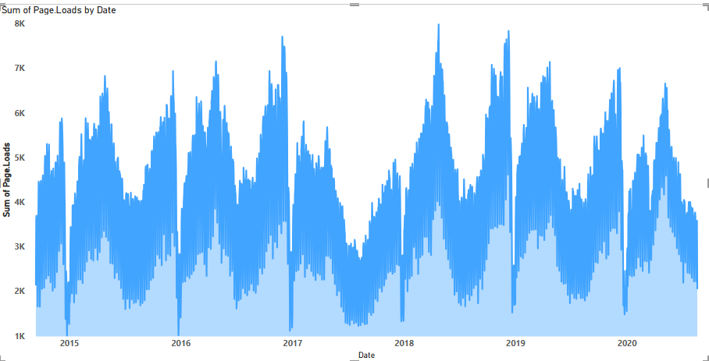
Exploratory Data Analysis Key Insights
we
“Website Traffic Trend and Seasonality
Analysis (2014–2020)”
Seasonality is clearly visible
The chart shows a repeating pattern every year.
Page Loads increase sharply during certain months,
then drop again — this indicates strong seasonal behavior
Upward Trend Over Years
From 2014 to 2019, the overall level of page loads
increases.
This suggests growing website popularity or user base
over time.

Slide 7
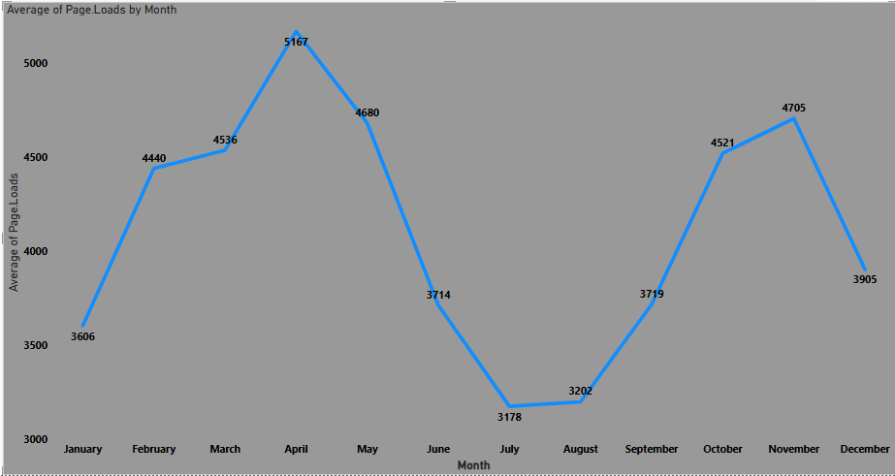
Visualization
Monthly Seasonality in Website Traffic
Monthly Seasonality in Website Traffic
1. Peak Traffic Months:
The highest average page loads occur in April (5167), followed by May (4680) and November (4705).
2. Lowest Activity Periods
July (3178) and August (3202) have the lowest page loads.
3. Traffic Recovery and Drop Patterns:
Traffic drops gradually from May to July, and then rises again from August to November.

Slide 8
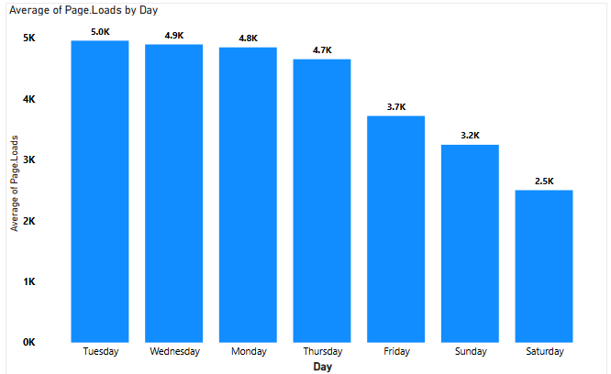
Weekday vs Weekend Traffic
1. Weekday Traffic
Page loads are significantly higher on weekdays (Monday to Thursday), peaking at 5.0K on Tuesday.
Tuesday, Wednesday, and Monday have the highest engagement.
2. Traffic Drops on Weekends
Saturday sees the lowest traffic at 2.5K, followed by Sunday at 3.2K.
This indicates reduced user activity during weekends.
3. Friday is a Transition Day
A noticeable drop starts on Friday (3.7K), suggesting the beginning of weekend disengagement.

Slide 9
Correlation Heatmap
The heatmap shows the correlation between different website traffic metrics:
Page_Loads is highly correlated with:
Unique_Visits (0.99): Almost perfect positive correlation. More unique visitors = more page loads.
First_TimeVisits (0.98) and Returning_Visits (0.91): Both contribute to overall traffic.
UniqueVisits and FirstTime.Visits have a perfect correlation (1.00) – meaning most unique visits are first-time visits.
Day.Of.Week has a weak negative correlation with other variables (~ -0.25). This suggests that traffic doesn't strongly depend on which day it is, but there might be a slight drop on certain days.

Slide 10
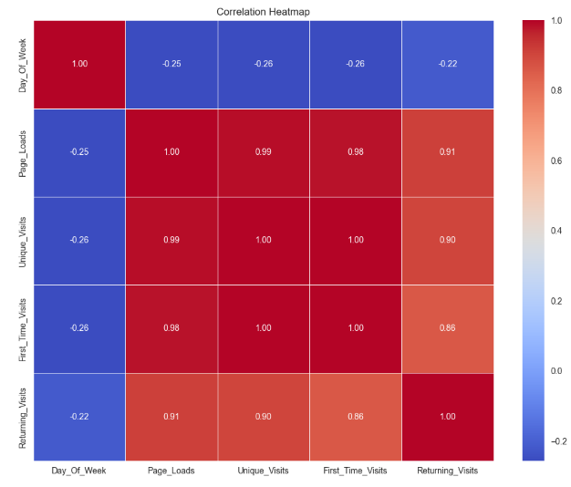

Slide 11
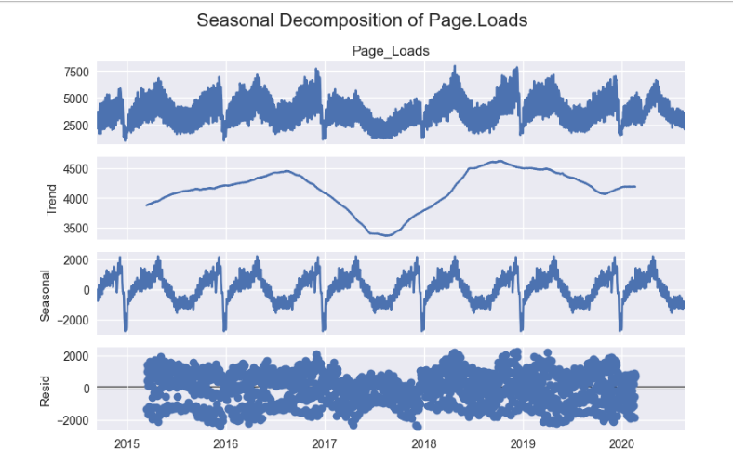
Seasonal Decomposition (Yearly)
1. Observed
This is the actual number of page loads over time.
It includes everything: trend, seasonality, and random noise.
We can see ups and downs that repeat every year.
1. Observed
This is the actual number of page loads over time.
It includes everything: trend, seasonality, and random noise.
We can see ups and downs that repeat every year.
2. Trend
This shows the overall direction of page loads from 2014 to 2020.
In the beginning, traffic was increasing.
Later, it became stable or slightly decreased, maybe due to changes
in user interest.
3. Seasonality
A pattern that repeats every year, like higher or lower visits in certain months.
For example, traffic might increase during specific seasons each year.
4. Residual
This shows the random ups and downs that are not explained by trend or seasonality.
These are small changes caused by unexpected events.
The values are close to zero, which means our model fits the data well.

Slide 12
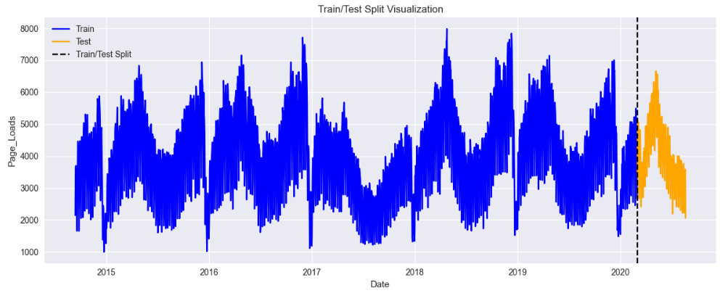
Train-Test Split for Time Series
Explanation
Time-based splitting is important in time series to keep the time order.
We use the first 80% of data (till Feb 2020) as training data.
The last 20% (6 months from Mar 2020) is used for testing.
This helps evaluate how well the model performs on future unseen data.
Show the plot where:
blue line = training period (2014–Feb 2020)
orange line = testing period (mar 2020–Aug 2020)
clearly shows the cut-off point, helping understand model training window and forecasting period.

Slide 13
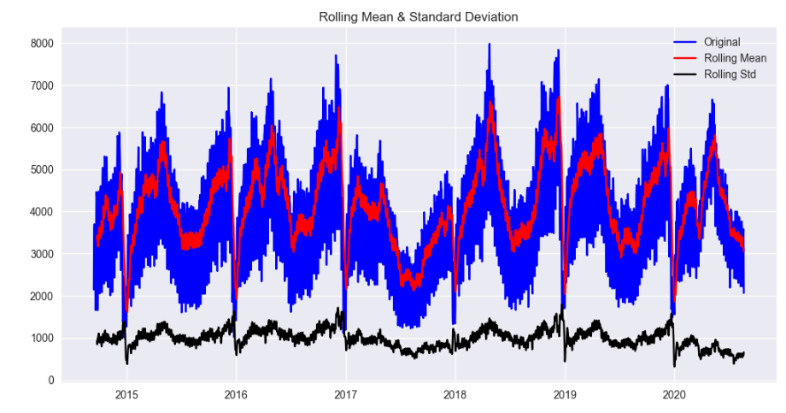
Stationarity Check – ADF Test
ADF Test Results:
ADF Test Results
ADF Statistic = -4.28
p-value = 0.00047
Critical Values:
1%: -3.43
5%: -2.86
10%: -2.56
Conclusion:
Since the ADF statistic (-4.28) < 1% critical value (-3.43) and the p-value (0.00047) < 0.05, the null hypothesis is rejected.
The data is stationary, meaning its statistical properties like mean and variance do not change over time.

Slide 14
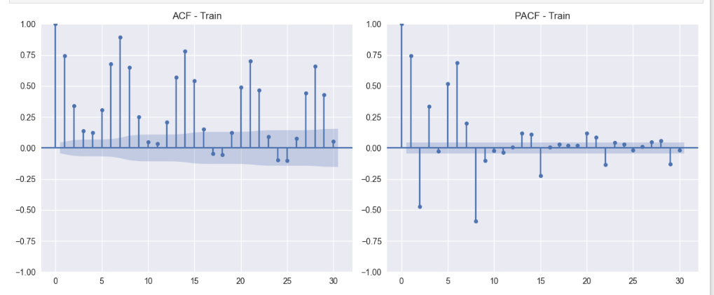
ACF & PACF Analysis
Purpose:
To identify the values of p (AR term) and q (MA term) for ARIMA model.
Helps understand autocorrelation and partial autocorrelation structure in the training data.
Purpose:
To identify the values of p (AR term) and q (MA term) for ARIMA model.
Helps understand autocorrelation and partial autocorrelation structure in the
training data.
ACF (Autocorrelation Function):
Shows correlation between current value and its lags.
Significant spikes at lags 1, 2, 6, 7, 13, etc.
Indicates presence of MA (q) terms.
PACF (Partial Autocorrelation Function):
Shows correlation after removing effects of earlier lags.
Significant spikes at lags 1, 2, 5, suggesting possible AR (p) terms.
Inference:
Based on ACF and PACF:
p (AR term) ≈ 2
q (MA term) ≈ 2
So, ARIMA(2, 0, 2) is a suitable choice (as ADF test confirmed stationarity d=0).

Slide 15
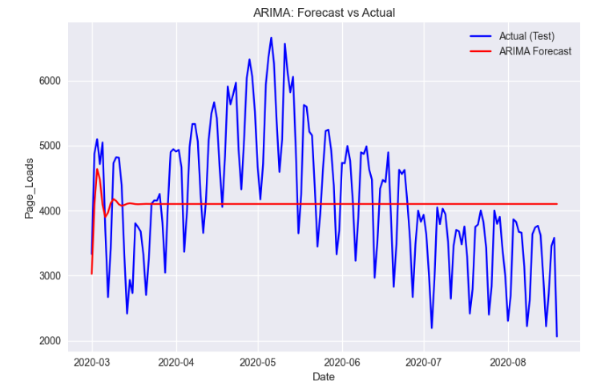
MODEL SELECTION FOR TIME SERIES
Model Details:
Model Used: ARIMA (Auto Regressive Integrated Moving Average)
Parameters:
p (AR order): Chosen based on PACF
d (Differencing order): Initially tried d=0 (non-stationary), which did not work well,so we used d=1 to make the series stationary.
q (MA order): Based on ACF.
Forecast Summary:
The red line represents the ARIMA forecast for the test period (Mar–Aug 2020).
The blue line shows the actual page loads.
ARIMA struggled to capture the seasonality and fluctuations in the data.
Evaluation Metrics:
MSE: 1,019,166
RMSE: 1009.54
MAPE: 21.10%
Insights:
The ARIMA model gave a relatively flat prediction, missing the cyclical peaks and drops.
This indicates ARIMA alone may not be enough for this dataset due to strong seasonal trends.
ARIMA Forecast vs Actual (Test Data)
The red line represents the ARIMA forecast for the test period (Mar–Aug 2020).
The blue line shows the actual page loads.
ARIMA struggled to capture the seasonality and fluctuations in the data
e red line represents the ARIMA forecast for the test period (Mar–Aug 2020).
The blue line shows the actual page loads.
ARIMA struggled to capture the seasonality and fluctuations in the data.
Forecast Summary:
The red line represents the ARIMA forecast for the test period (Mar–Aug 2020).
The blue line shows the actual page loads.
ARIMA struggled to capture the seasonality and fluctuations in the data.
ARIMA Forecast vs Actual (Test Data)

Slide 16
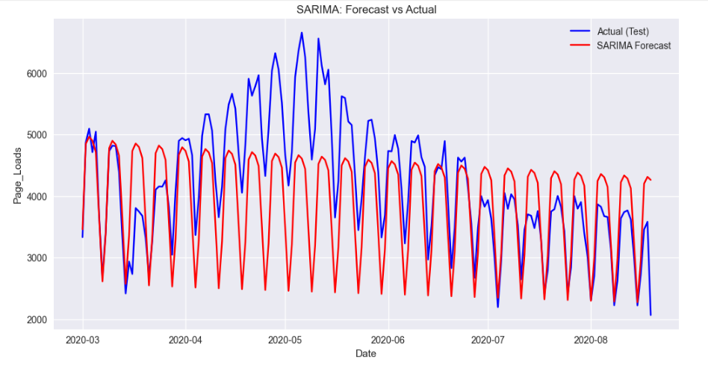
SARIMA MODEL
Model Performance Metrics:
MSE (Mean Squared Error): 727,520.75 ↪ Shows the average squared difference between actual and forecasted values — lower is better.
RMSE (Root Mean Squared Error): 852.95 ↪ Indicates the standard deviation of prediction errors — useful for interpreting in
the original unit (Page_Loads).
MAPE (Mean Absolute Percentage Error): 15.57% ↪ Indicates that, on average, the model’s predictions are off by 15.57% — this is moderately accurate for real-world forecasting.
2. Visual Pattern Observation (From the Plot):
The actual values (blue line) show noticeable weekly seasonality and some randomness.
The SARIMA forecast (red line) captures:
Regular seasonality quite well (smooth up-down patterns).
But underestimates peak values in some months (especially May-June).

Slide 17
SARIMAX Model FORCASTING
1. Model Performance Metrics:
MSE (Mean Squared Error): 10,373.87 ↪ Extremely low error — this means the predicted values are very close to the actual ones.
RMSE (Root Mean Squared Error): 101.85 ↪ On average, the forecasted page loads deviate by only ~102 units from the actual.
MAPE (Mean Absolute Percentage Error): 2.07% ↪ Very high accuracy – this model is only off by ~2%, which is excellent in time series forecasting
2. Visual Pattern Observation (From the Plot):
The green SARIMAX forecast almost perfectly aligns with the blue actual values.
The model captures:
Seasonal patterns
Volatility and sudden drops
Peaks and dips more accurately than SARIMA
Very little visual difference between actual and forecasted line — shows strong predictive performance.
.

Slide 18
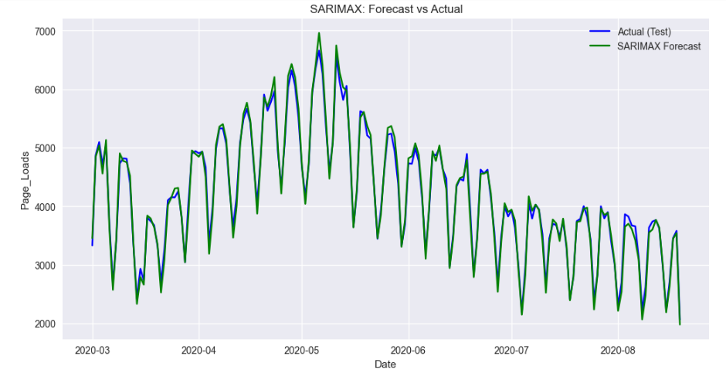
Insights:
SARIMAX achieved very high accuracy (only 2.07% error).
Outperforms SARIMA in capturing real trends and fluctuations.
Effectively utilizes external features (exogenous variables) for improved forecasting.
Suitable for real-time prediction and business decision-making.

Slide 19
MODEL PERFORMANCE EVALUATION USING RMSE & MAPE
TIME SERIES MODEL | Mean Squared Error | Mean Squared Error | Mean Squared Error
ARIMA MODEL | 1019166.06 | 1009.54 | 21.10%
SARIMA MODEL | 727520.75 | 852.95 | 15.57%
SARIMAX MODEL | 10373.87 | 101.85 | 2.07%

Slide 20
MACHINE LEARNING MODEL FOR TIME SERIES

Slide 21
Feature Engineering
Extracted Date Features: Converted date column into useful features:
Day, Day of Week, Month, etc.
Lag Features: Created lag variables (previous time steps) to help the model learn trends.
Correlation Analysis:
Checked correlation between features and target variable (Page Loads).
Dropped features with low/no correlation.

Slide 22
MODEL SELECTION AND TRAINING
Various Machine Learning Models were evaluated select the most effective approach website traffic forecasting.
Linear Regression
LGBM REGRESSOR
Random Forest
XG Boost classifier
Train &Test split
Test
20%
Train
80%

Slide 23
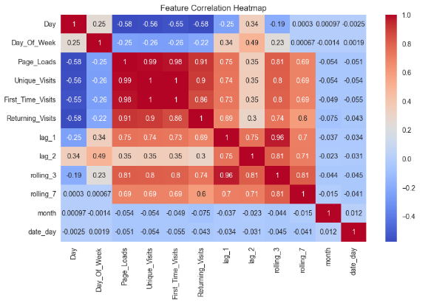
Correlation Heatmap
.
.
Highly correlated with Page_Loads: Unique_Visits (0.99), First_Time_Visits (0.98), Returning_Visits (0.91) – important predictive features.
Lag & Rolling features: lag_1, lag_2, rolling_3, rolling_7 show moderate positive correlation – useful for capturing trends
Low impact features: Day, Day_Of_Week, month, date_day – weak correlation, limited predictive value.
Multicollinearity alert: Unique_Visits & First_Time_Visits have near-perfect correlation – may need feature reduction

Slide 24
Linear Regression Model – Evaluation & Results
Linear Regression Implemented using Grid Search CV with 5-fold cross-validation to find the best hyperparameters.
Model Performance Metrics:
MSE = 84,944.60, RMSE = 291.45, MAPE = 5.78% , R² Score = 0.9395
Interpretation:
High R² Score (0.93) indicates a strong fit.
MAPE of 5.78% means the model's average prediction error is quite low.
RMSE and MSE show stable performance without overfitting.
Conclusion:
Linear Regression with tuned parameters performs very well on this time-series problem.
Suitable for baseline forecasting due to its simplicity and interpretability.

Slide 25
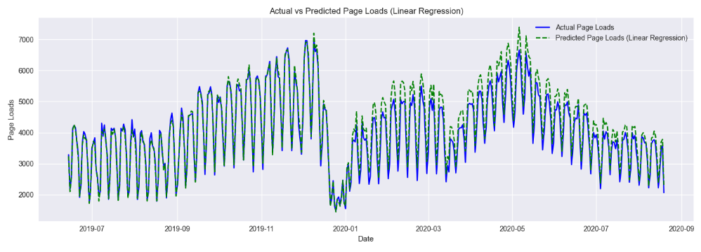
The graph clearly shows that the predicted values (green dashed line) closely follow the actual values (blue line) over time. This confirms that the model has learned the seasonal and trend patterns effectively.

Slide 26
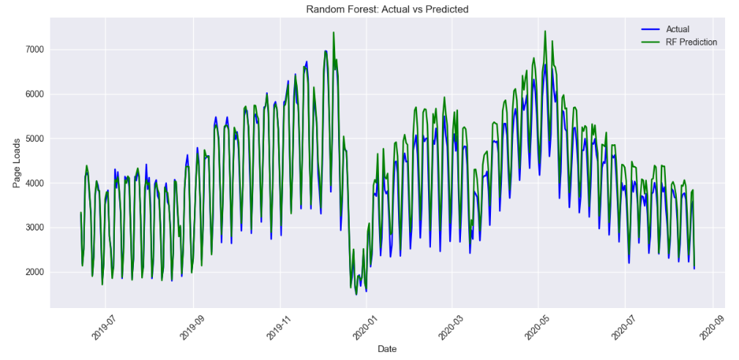
Random Forest classifier
Evaluation :
Random forest MSE: 94209.37 Random forest RMSE: 306.94 Random forest MAPE: 6.13% Random forest R² Score: 0.93

Slide 27
XG Boost model
LGBM Regressor
Model Evaluation Metrics:
MSE 92,379.64
RMSE 303.94
MAPE 6.04%
R² Score 0.93
Model Evaluation Metrics:
MSE 88312.61
RMSE 297.17
MAPE 5.89%
R2 Score 0.94
Both models provide high forecasting accuracy (R² > 0.93), making them suitable for predicting website page loads.
Light GBM performs slightly better with lower MSE, RMSE, and MAPE, and a higher R² score.
Light GBM is more efficient and faster, making it a better choice for large-scale or real-time forecasting applications.

Slide 28
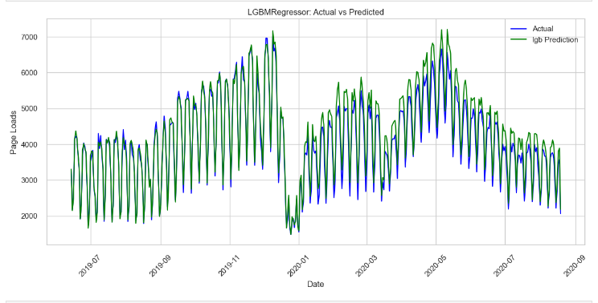
Observation: Actual vs Predicted
The LGBM Regressor model shows a strong alignment between actual and predicted page loads, capturing both seasonal patterns and sudden traffic changes effectively. The model performs well even during high-fluctuation periods, making it a reliable choice for accurate website traffic forecasting.
Regressor model shows a strong alignment between actual and predicted page loads, capturing both seasonal patterns and sudden traffic changes effectively. The model performs well even during high-fluctuation periods, making it a reliable choice for accurate website traffic forecasting.

Slide 29
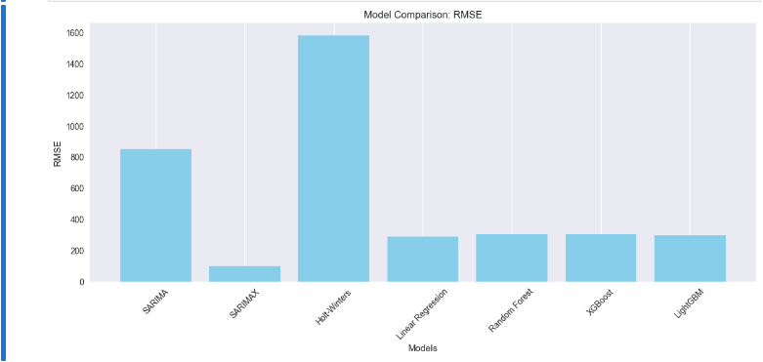
MODEL Comparison

Slide 30
Conclusion
In this project, we forecasted website traffic using both statistical and machine learning models. After preprocessing, exploring key variables like Page Loads, Unique Visits, and Returning Visits, we built models such as SARIMA, SARIMAX, Holt-Winters, Linear Regression, Random Forest, XG Boost, and Light GBM. Among these, Light GBM performed the best, with the lowest error (RMSE: 297.17, MAPE: 5.89%) and highest accuracy (R²: 0.937), making it the most reliable model for traffic prediction. The feature Page Loads was the target metric, while Unique and Returning Visits were key indicators that strongly correlated with future traffic patterns. These insights can help the business in predicting demand, optimizing server loads, targeting frequent vs. new users, and planning digital marketing strategies effectively.

Slide 31
How the Best Model Helps in Future Forecasting
The selected LGBM Regressor model AND SARIMAX provides highly accurate predictions of website traffic. It captures both seasonal and sudden changes in user visits, enabling the business to:
Predict traffic surges and plan server resources
Optimize marketing campaigns by forecasting user engagement
Improve decision-making through data-backed traffic trends

Slide 32
THANK YOU

